Slide 1


Slide 2

Introduction to JAVA
Topic/Course
Sub-Topic (Example: name of college)
Program Internal

Slide 3
Why and How Java?
History of Java
Why Java?
Where Java?
Difference between JDK, JRE, JVM
Notes:
The first high-level programming language was Plankalkül, created by Konrad Zuse between 1942 and 1945^{[1]}. The first high-level language to have an associated compiler was created by Corrado Böhm in 1951, for his PhD thesis. The first commercially available language was FORTRAN (FORmula TRANslation); developed in 1956 (first manual appeared in 1956, but first developed in 1954) by a team led by John Backus at IBM.
When FORTRAN was first introduced it was treated with suspicion because of the belief that programs compiled from high-level language would be less efficient than those written directly in machine code. FORTRAN became popular because it provided a means of porting existing code to new computers, in a hardware market that was rapidly evolving; the language eventually became known for its efficiency.

Slide 4
Compiling our first Program
Install the JDK if you don't have installed it.
Set path of the jdk/bin directory.
Create the java program (preferred notepad)
Compile and run the java program (Assuming program is saved as Hello.java
For compiling : javac Hello.java
For executing : java Hello

Slide 5

public class Main
{
public static void main(String[] args)
{
System.out.println(“Welcome to FACE”);
}
}
1
2
3
4
5
6
7
8
9
10
11
12
13
14
15
Welcome to FACE
Output
Notes:
class keyword is used to declare a class in java.
public keyword is an access modifier which represents visibility. It means it is visible to all.
static is a keyword. If we declare any method as static, it is known as the static method. The core advantage of the static method is that there is no need to create an object to invoke the static method. The main method is executed by the JVM, so it doesn't require to create an object to invoke the main method. So it saves memory.
void is the return type of the method. It means it doesn't return any value.
main represents the starting point of the program.
String[] args is used for command line argument. We will learn it later.
System.out.println() is used to print statement. Here, System is a class, out is the object of PrintStream class, println() is the method of PrintStream class. We will learn about the internal working of System.out.println statement later.

Slide 6

During Compile time
After writing our first program, we compile them.
Hello.class can be used in different operating system
Notes:
Programming languages such as Java are relatively verbose and expensive to parse and analyze at runtime. You could write an interpreter that reads the Java source the same way a human would, but it is much more efficient to translate the human-friendly code into a representation that is much closer to the hardware you are eventually running the code on. The program would run much faster that way. This is why programming languages such as Java are compiled. Now, the question is what to compile the Java source into?
If you were to compile Java directly into "native code", it would run only on the architecture that you translated it to. This is usually the case for code written in C++, for instance, where you can end up with an executable that runs on Windows, but not iOS. If you care about your code running on multiple platforms, without needing to recompile it, you can invent what we call a "virtual machine". Java uses a virtual machine, which we refer to as the JVM. The JVM comes with its own "native instruction" set, called Java bytecodes. If you compile Java source files, you end up with .class files, containing those byte codes. You then have to implement one VM per target environment to give you the "write once, run anywhere" behavior Java is so famous for. When designing your VM, you get to chose between two execution modes. Aside from control flow, your VM will have to basically deal with values, and operations on them. A register-based machine will store operands in registers and the operators operate on those registers. It would compile something like "x = 5 * 3" into "Store 5 in register 1. Store 3 in register 2. Multiply register 1 and 2 and store the result in register 3." In contrast, a stack-based language would say "Load 5 onto the stack. Load 3 onto the stack. Multiply the top two elements and replace them with the result". Java uses a stack-based byte code language (similar to Forth and PostScript). In Java bytecodes, initialization of local variables is done using stack operations. Both stack and register approaches have their own advantages and opportunities for optimization. One optimization used by Java, for example, is that the compiler locates multiple references to the same identical string in your code, and only emits one single constant string in the bytecode, to avoid making the .class file needlessly big and to also save memory allocation at runtime. At runtime, the virtual machine parses the byte codes and converts them into an internal memory representation. It will find references to other .class files and load those recursively. Once all classes are converted into an internal data structure, the JVM starts "interpreting" that data structure. In other words, it finds an entry point (such as a "main" function) and executes the byte codes in sequential order. Some byte codes let you call functions. Those functions are then retrieved and their bytecodes are executed. Some byte codes create objects. Those objects are allocated from a heap. At some point, when all references to a given object are lost, the VM can safely delete that object. This memory de-allocation process is referred to as garbage collection. Interpreters tend to be slow. They basically wJava byte codes, the JVM keeps traalk a data structure and do a lot of bookkeeping that is simply one layer of abstraction above a much more efficient native instruction set. Byte codes are more abstract and tend to take less space than native code (about 8X). To selectively speed up ck of "hot" code, ranges of code that are executed often. It is worthwhile to spend the extra cycles to compile those byte codes another time, this time down to native code, and then use the twice-compiled code. As the second compilation step is happening so late, it is referred to as Just-in-time (JIT) compilation. JIT code basically runs the same as byte codes, it just runs faster, at the cost of more memory. This is a clear example of performance being a space-time tradeoff. Finally.... if I have not lost you yet, there is more! You can make a conscious space-time tradeoff by using so-called ahead-of-time (AOT) compilation. This forces the application of the JIT process during the normal Java compilation step. Rather than ship a set of byte codes, you would ship the native code generated by the JIT. This approach works well for server-side applications as it shortens startup time and also reduces warm up time of expensive code (as we don't need to run the JIT at runtime).

Slide 7
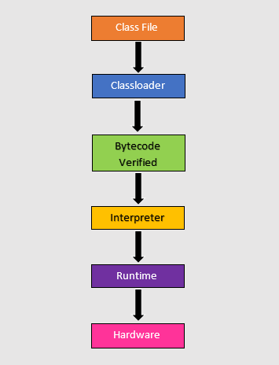
During runtime

Slide 8
Types of Java Application
Standalone Application
Web Application
Enterprise Application
Mobile Application
Notes:
https://www.javatpoint.com/java-tutorial

Slide 9
Types of Java Editions
Java SE – Standard Edition
Java EE – Enterprise Edition
Java ME – Micro Edition
JavaFX
Notes:
https://www.javatpoint.com/java-tutorial

Slide 10
JVM Architecture
JVM works with …
Loads code
Verifies code
Executes code
Provides runtime Environment
JVM gives the definitions …
Memory area
Class file format
Register set
Garbage-collected heap
Fatal error reporting etc.
Notes:
https://www.javatpoint.com/internal-details-of-jvm

Slide 11
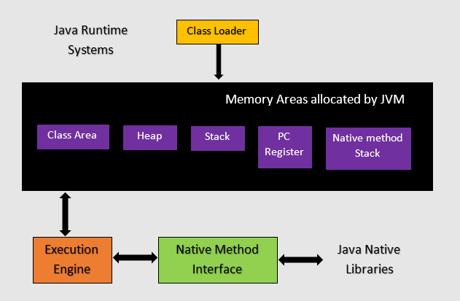
JVM Architecture
Notes:
https://www.javatpoint.com/internal-details-of-jvm

Slide 12
Path Setting
Temporary Path
Permanent Path
Use of editors – Sublime editor, code block
Notepad – Execute a program
Notes:
https://www.geeksforgeeks.org/set-temporary-permanent-paths-java/

Slide 13
Why is JAVA Platform Independent?
Notes:
Platform independent language means once compiled you can execute the program on any platform (OS).
Java is platform independent. Because the Java compiler converts the source code(Hello.java) to bytecode, which is Intermidiate Language to Bytecode(Hello.class), which can be executed on any platform (OS) using JVM( Java Virtual Machine).
In reality, nothing is perfectly platform independent. There are always some constraints on specific platforms that cannot be ignored. Examples are things like the maximum length of filenames, or the available RAM on a system. No matter how much you try to be platform independent, your code may fail if you try to run it on a platform that is too tightly constrained. There are occasionally bugs in language implementations that only occur on certain platforms. So even if your code is theoretically 100% portable, you still need to test it on different platforms to make sure you aren't running into any unusual bugs!
Overall, Java is probably about as close to true platform independence as you can get, but as you can see there is still quite a bit of platform-specific work done under the hood. If you stick to 100% pure Java code and libraries, you can count on Java as being "effectively" platform independent and it generally lives up to the Write Once Run Anywhere (WORA) promise. But you should still test it!!

Slide 14
Why is JAVA both interpreted and compiled language?
Notes:
Programming languages are classified asHigher Level Language Ex. C++, Java
Middle-Level Languages Ex. C
Low-Level Language Ex Assembly
finally the lowest level as the Machine Language.
A compiler is a program which converts a program from one level of language to another. Example conversion of C++ program into machine code.
The java compiler converts high-level java code into bytecode (which is also a type of machine code).
An interpreter is a program which converts a program at one level to another programming language at the same level. Example conversion of Java program into C++
In Java, the Just In Time Code generator converts the bytecode into the native machine code which are at the same programming levels.
Hence, Java is both compiled as well as interpreted language.

Slide 15
Why is JAVA both interpreted and compiled language?
Notes:
Programming languages are classified asHigher Level Language Ex. C++, Java
Middle-Level Languages Ex. C
Low-Level Language Ex Assembly
finally the lowest level as the Machine Language.
A compiler is a program which converts a program from one level of language to another. Example conversion of C++ program into machine code.
The java compiler converts high-level java code into bytecode (which is also a type of machine code).
An interpreter is a program which converts a program at one level to another programming language at the same level. Example conversion of Java program into C++
In Java, the Just In Time Code generator converts the bytecode into the native machine code which are at the same programming levels.
Hence, Java is both compiled as well as interpreted language.

Slide 16
Why is JAVA slow?
Notes:
he two main reasons behind the slowness of Java are
Dynamic Linking: Unlike C, linking is done at run-time, every time the program is run in Java.
Run-time Interpreter: The conversion of byte code into native machine code is done at run-time in Java which furthers slows down the speed
However, the latest version of Java has addressed the performance bottlenecks to a great extent
A linker is a program that takes individual compiled files and combines them into a single executable program.
Imagine you have a program with two files: one has the main function that starts the program, the other defines a helper function. When the compiler works on the main file it will produce code that calls the helper function without actually knowing if it exists or what it does. Then the linker takes over and "resolves" the function call, so that the right function is entered when the program is run.
There are basically two types of linkers:
a static linker runs before execution, producing an executable program file or a library.
a dynamic linker runs while the program runs, looking up needed symbols in different libraries.
Usually the linker concept is applied only to native code, on the OS level. If you want to apply it to Java, you could say that it uses a dynamic linking only; the linker is integrated into the JVM.

Slide 17

THANK YOU

